Slide 1
Evaluation: IMSM
10/04/2024, Thanmaya, Mus2Vid

Slide 2
Overview of progress on tasks
Completed IMSM implementation for MelBench dataset
Ran few personal tests
Set up the IMSM implementation to run on our model output on Gilbreth (need to test it out)

Slide 3
Problem statement
Find a Metric to rate how similar images and audio pairs are
This relates to our project because we will see how our model is performing

Slide 4

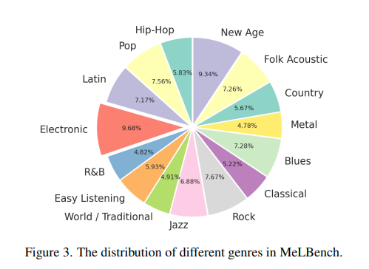
IMSM implementation for MelBench dataset
Utilizes CLIP and CLAP scores to get a music and image similarity
MelBench dataset
A CSV file with text descriptions, youtube links, and image paths
Images seems to be a screenshot of the youtube video
Ran IMSM calculations on MelBench dataset

Slide 5
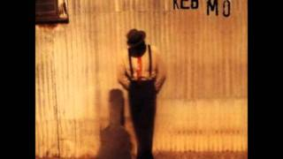
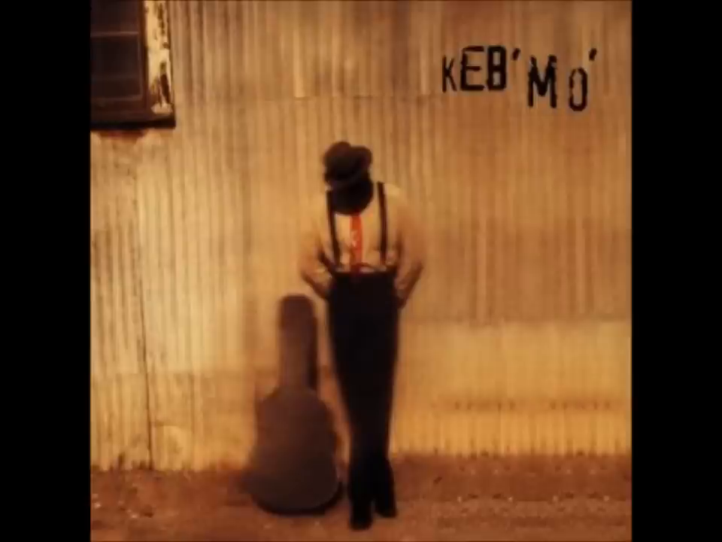
Low IMSM score: MelBench
Score: -0.04753
Text: The track falls within the blues genre, evoking a blend of melancholy and determination. It features acoustic and electric guitars, rhythmic percussion, bass, and occasional keyboard accents, starting with acoustic guitar picking and gradually introducing other instruments. The central theme explores introspection and questioning life choices, delving into uncertainties and reflecting on the journey. In a potential video, it might be recorded in a simple, intimate setting with minimal background noise, allowing the music to take center stage. The vocals are emotive and heartfelt, conveying vulnerability and contemplation.

Slide 6
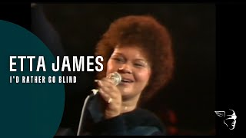
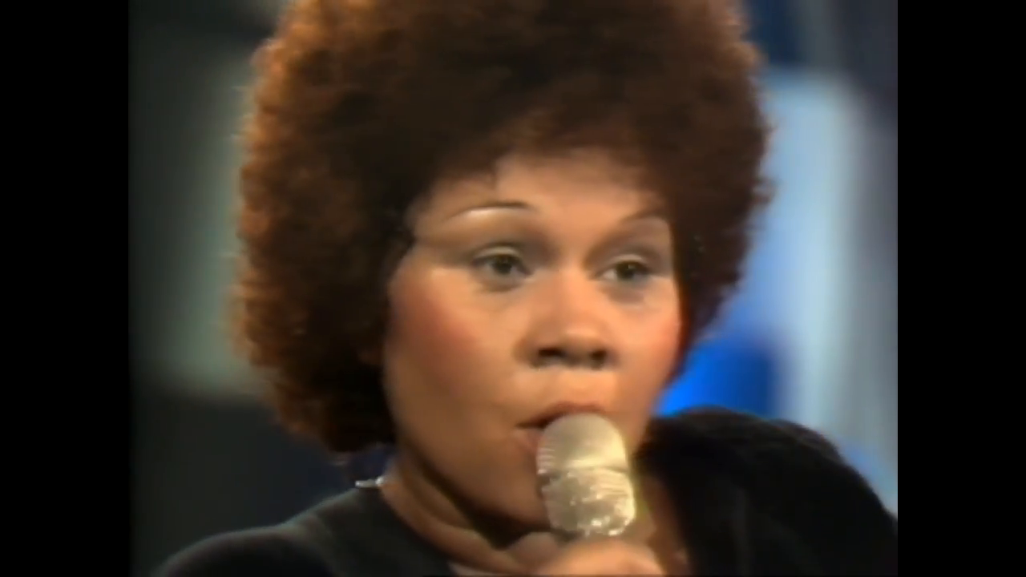
High IMSM score: MelBench
Score: 0.048997
Text: The track belongs to the blues genre, evoking a somber and heart-wrenching emotional landscape, reflecting the deep sadness and pain of lost love. It is characterized by emotive and soulful vocals that convey the profound emotions associated with blues music. The instrumentation typically includes electric guitar, piano, drums, and bass, with the electric guitar often taking a prominent role, delivering expressive and soul-stirring bluesy solos. The central theme revolves around heartbreak and the emotional struggle of losing love, delving into the pain and despair associated with such loss, and longing for what once was.

Slide 7
Possible problems (and possible solutions)
Problem: These scores are too low especially with the scores mentioned in the MelFusion Paper
Truncation of both the audio and text input could offer less valuable portions of the data
Possible solution: Tokenize the text input, remove any stop words to get the most meaningful portions of the text
Since the image is a screenshot of the video the image may not fit the same aesthetic or vibe of the song/text description
My code is slightly different than how the MelFusion code computes the score (Next Step: test changed code)

Slide 8

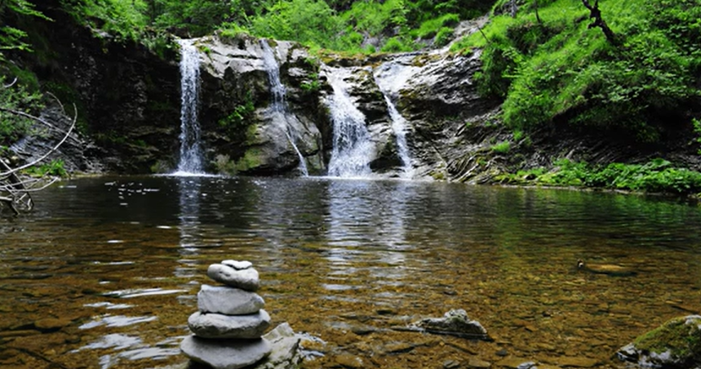
River Data
River Text
River Audio
River Image
Soothing ambience of flowing water and a forest creek, making it ideal for relaxation, focus, meditation, or sleep.
+
+
=
IMSM Score: 0.030864039435982704
CLIP Score: 0.2997890114784241
CLAP Score: 0.10295253992080688

Slide 9


Piano Data
Piano Text
Piano Audio
Piano Image
a soft, flowing piano composition with a gentle, romantic feel. The melody is simple yet deeply emotive, creating a tranquil and introspective atmosphere.
+
+
=
IMSM Score: 0.00964545551687479
CLIP Score: 0.2656520903110504
CLAP Score: 0.03630860149860382

Slide 10

Random Data
Piano Text
River Audio
Stuffed Animal Image
a soft, flowing piano composition with a gentle, romantic feel. The melody is simple yet deeply emotive, creating a tranquil and introspective atmosphere.
+
+
=
IMSM Score: -0.0135311558842659
CLIP Score: 0.20003533363342285
CLAP Score: -0.06764382869005203

Slide 11
Side by Side Comparison
River Data
Piano Data
Random Data
IMSM Score: 0.0308
CLIP Score: 0.2997
CLAP Score: 0.1029
IMSM Score: 0.0096
CLIP Score: 0.2656
CLAP Score: 0.0363
IMSM Score: -0.0135
CLIP Score: 0.2000
CLAP Score: -0.0676
Notes:
Piano could of cut of the important parts of the song
CLAP (audio) is consistently lower than CLIP (image)

Slide 12
Next Steps:
Test IMSM on our data set to see results
Try different code for IMSM
Try using Gilbreth

